Slide 1
From Flexible Frontier to
Fixed Boundary Evidence
HY5419 DIGITAL HISTORY
QING KAREN POSTS AND SINO-RUSSIAN BOUNDARY MAKING
How were selected karen posts interpreted and mobilised differently in boundary negotiations, and what does this reveal about the transformation of a flexible frontier into a fixed territorial boundary?
Wang Yihan · Week 6 progress report · 15 September 2026
Notes:
ENGLISH SCRIPT
Good afternoon. My project asks how flexible frontier information became evidence for a fixed territorial boundary. It grows out of my undergraduate research on Qing karen posts and the Sino-Russian northwest boundary negotiations. I do not treat the border as a line that already existed. I ask how historical actors selected and interpreted spatial information during the negotiations.
中文理解
大家好。我的项目研究弹性的边疆信息如何变成固定领土边界的证据。这个项目来自我本科阶段关于清代卡伦与中俄西北划界谈判的研究。我不会预先把国界理解成一条已经存在的线。我想考察谈判中的历史行动者如何选择和解释空间信息。
SOURCES AND LIMITS
Project framing follows HY5419_Karen_Project_Confirmed_Action_Plan.md and the Week 6 living progress notes. The argument about Russian use of ambiguity remains a working interpretation that requires archival verification.

Slide 2
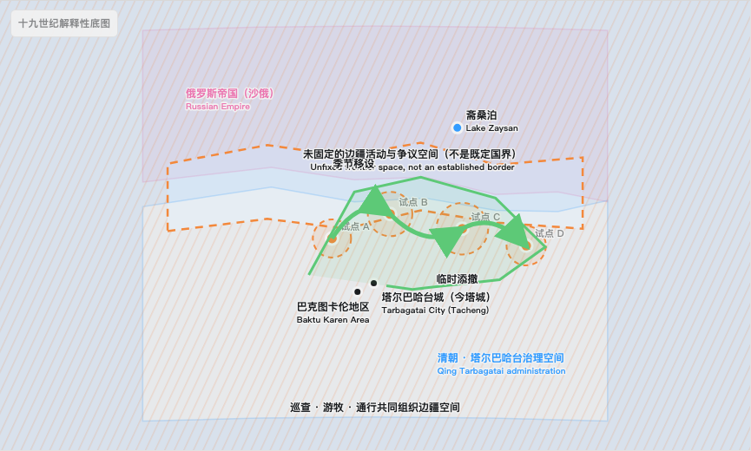
Exact point maps erase movement and uncertainty
KAREN STATES IN THE SOURCES
Permanent
A post may remain in use for a longer period.
Seasonally relocated
Its position may change with grazing and patrol cycles.
Temporarily added or withdrawn
Presence can respond to immediate administrative needs.
Approximately located
The record may support an area or corridor, not one coordinate.
Location uncertainty is part of the historical evidence.
02
Notes:
ENGLISH SCRIPT
At first, I planned to place selected karen posts on a map as points. The GIS seminar made me see a problem with this approach. Some posts remained in one place, but others moved with the seasons. Some were added for a short time or later withdrawn. Many sources also give only approximate locations. In a future QGIS test, I hope to use points only when the evidence is strong. I may use areas or corridors for mobile or uncertain locations.
中文理解
一开始，我计划把选出的卡伦标成地图上的点。GIS 课程让我看到了这种做法的问题。有些卡伦较为固定，另一些会随季节移动。有些只在短时间内添设，后来又被撤除。很多史料也只能提供大致位置。在之后的 QGIS 测试中，我希望只在证据充分时使用精确点。对于移动或位置不确定的卡伦，我可能会使用范围或走廊。
SOURCES AND LIMITS
Conceptual map only. Prototype records A–D do not represent verified historical coordinates. Categories derive from the project notes and source inventory plan.

Slide 3
Proposed workflow and open questions
These are goals for the next stage, not completed analyses.
01
02
03
04
Source review
Proposed dataset
QGIS trial
StoryMap trial
Test which records can support a small spatial comparison.
Explore how to store time, movement, uncertainty, and perspective.
Ask whether layers and time phases can reveal more than the animation.
Explore how to explain the evidence and gaps to a public audience.
The main uncertainty is how to turn approximate historical descriptions into useful digital analysis without creating false precision.
03
Notes:
ENGLISH SCRIPT
This slide shows the workflow I hope to test. It is not a completed method. I would begin by reviewing which source records can support a small spatial comparison. I would then build a small source-linked dataset. Next, I would test selected phases and competing claims in QGIS. If that comparison works, I would use StoryMap to explain the evidence and its gaps to the public. My main difficulty is turning approximate locations and relationships into digital data without creating false precision.
中文理解
这一页展示的是我希望测试的工作流程。目前它还只是一个构想。我会先检查哪些史料记录能够支持小规模的空间比较。然后，我会建立一个与史料出处相连的小型数据集。下一步是在 QGIS 中测试少数历史阶段和彼此竞争的主张。如果这种比较可行，我再用 StoryMap 向公众解释证据和空白。现在最大的困难，是怎样把大致位置和关系转换成数字数据，同时避免制造虚假的精确性。
SOURCES AND LIMITS
Instructor feedback suggests that a small dataset, spatial analysis, and StoryMap may fit the course timeframe. Their exact implementation remains to be tested. Historical-map georeferencing depends on source suitability.

Slide 4
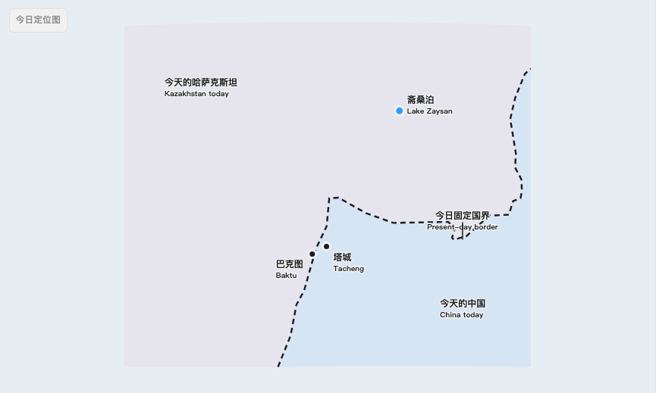
Proposed pilot scope and provisional records
PROPOSED PILOT REGION
塔尔巴哈台—斋桑—巴克图
Tarbagatai–Zaysan–Baktu
TARGET DATASET SIZE
10–15 documented records
Initial QGIS test: 5 records
PROVISIONAL FIELDS
Name and type
Date and precision
Original location wording
Geometry and certainty
Movement or withdrawal
Qing and Russian readings
Source and page
Boundary relevance
A–D in the animation are placeholders awaiting archival replacement.
04
Notes:
ENGLISH SCRIPT
The map on the left is a modern locator map. It helps the audience identify the region. It does not represent the nineteenth-century boundary. For the pilot, I am considering the Tarbagatai, Zaysan, and Baktu region. I aim to collect ten to fifteen source-linked records and begin with five provisional records. I still need to test whether each record should become a point, an area, a route, or an unlocated entry. These fields are a working design for QGIS, not a finished dataset.
中文理解
左侧是现代定位图。它帮助观众辨认研究区域，并不代表十九世纪的边界。作为试点，我暂时考虑塔尔巴哈台、斋桑和巴克图地区。我的目标是收集十到十五条与史料出处相连的记录，并先从五条暂定记录开始。我仍需检验每条记录应该转化成点、范围、路线，还是无法定位的条目。这些字段只是为 QGIS 准备的工作设计，还不是完成的数据集。
SOURCES AND LIMITS
The pilot area, record count, and fields remain provisional. Modern borders in the locator map provide orientation only.

Slide 5
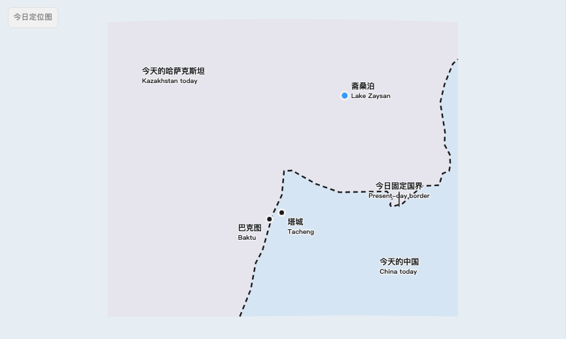
Current progress: an interactive map prototype
1
Today’s map
Locate the region without projecting the modern border backward.
2
Nineteenth century
Show karen movement, then the Qing and Russian claims.
3
Slider comparison
Compare how the same records support different spatial arguments.
A visual experiment, not yet a QGIS analysis.
karen-case-animation.yihanw326.chatgpt.site
05
Notes:
ENGLISH SCRIPT
The main result I can show now is this interactive animation. It is one possible way to present the map. The first chapter uses today’s border and place names only to orient the audience. The second chapter removes the modern border. It tests ways to show movement, uncertainty, and relationships. It then compares the Qing and Russian interpretations. This prototype helps me define the visual problem. It is not yet QGIS analysis and cannot replace archival evidence.
中文理解
目前我能够展示的主要成果，是这个交互动画。它是地图呈现的一种可能方式。第一章只利用今天的国界和地名帮助观众定位。第二章移除现代国界，尝试展示移动性、不确定性和不同关系，然后比较清方与俄方的解释。这个原型帮助我明确视觉表达的问题。它还不是 QGIS 分析，也不能代替档案证据。
SOURCES AND LIMITS
Live prototype: https://karen-case-animation.yihanw326.chatgpt.site. The nineteenth-century base is interpretive rather than a georeferenced reconstruction. Prototype records A–D remain placeholders.

Slide 6
From visual prototype to digital method
THE ANIMATION TESTS
WHAT I WANT TO TRY
QUESTIONS I STILL HAVE
How movement might appear
Translate sources into QGIS layers
Can QGIS add historical insight?
How relationships might be shown
Test phases and competing claims
How can I avoid false precision?
How two claims can be compared
Use StoryMap for public explanation
Is the full workflow manageable?
CENTRAL QUESTION
How can I move from a visual explanation of mobility and relationships to a feasible QGIS analysis and public StoryMap?
06
Notes:
ENGLISH SCRIPT
My main challenge is moving from this visual prototype to a workable digital method. The animation can suggest movement, uncertainty, and competing interpretations. I still do not know which QGIS functions can add historical insight, rather than simply redraw the same image. I am also unsure how much of the analysis I can turn into a StoryMap within the course timeframe. I would welcome advice on feasibility, the role of QGIS, and how to preserve uncertainty while offering public value.
中文理解
我现在最主要的困难，是怎样从这个视觉原型走向可操作的数字方法。动画可以提示移动性、不确定性和竞争性的解释。但我还不确定 QGIS 的哪些功能能够带来新的历史认识，而不只是重新绘制同一幅图。我也不确定在课程时间内，能够把多少分析转化成 StoryMap。我希望获得关于可操作性、QGIS 应承担的作用，以及如何在保留不确定性的同时创造公共价值的建议。
SOURCES AND LIMITS
QGIS and StoryMap remain proposed tools. The animation is the current prototype. Public value remains a goal to be tested through clearer explanation of evidence and uncertainty.

